Slide 1
MSSP 608: Practical Machine Learning Methods Week 11
1

Slide 2
House Keeping
Assignment 4 due Friday, 4/8 at 11:59 PM EST
PLEASE TURN IN GOOGLE COLAB LINK (ONE POINT DEDUCTION FOR TURNING IN LATE. ANOTHER FOR NOT TURNING IN VIA GOOGLE COLAB)
Assignment 5 cheat sheet posted
Quiz 9 – 95% average
No quiz due this week

Slide 3
Road Map…
Validation | ML Algorithms
 | Supervised | Unsupervised | Other
 | Decision trees | Prin. Comp. Anal. (PCA) | Data exploration (last week)
Test/train (hold out cross validation) | Linear regression | K-means | Algorithmic Fairness
K-fold cross-validation | Logistic regression |  | Text analysis (NLP) – part 1
Stratified cross-validation | Random Forests (bagging method) |  | Bayes (email example)
Hyperparameter tuning (ridge, lasso, elastic net regression) | Support vector machines (SVM)
Ensemble learning | K-nearest neighbors (knn)
Bagging
Boosting

Slide 4
Next 4 weeks
Week 11:
NLP part 1
Week 12:
NLP part 2
Week 13:
Bayes theorem applications (spam)
Week 14:
Sign up for 20-30 minute blocks to discuss group project

Slide 5
Next 4 weeks
Week 11 (THIS WEEK):
NLP part 1
Week 12:
NLP part 2
Week 13:
Bayes theorem applications (spam)
Week 14:
Sign up for 20-30 minute blocks to discuss group project

Slide 6
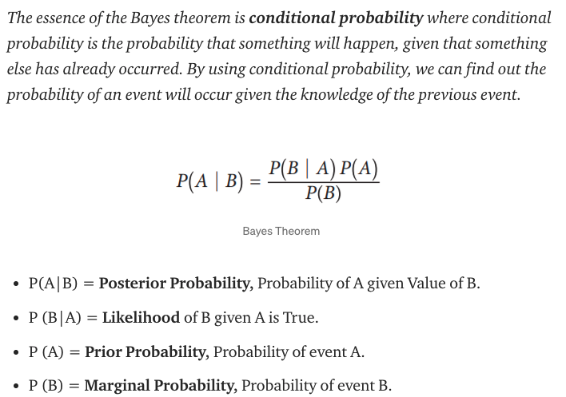
Bayes Theorem:

Slide 7
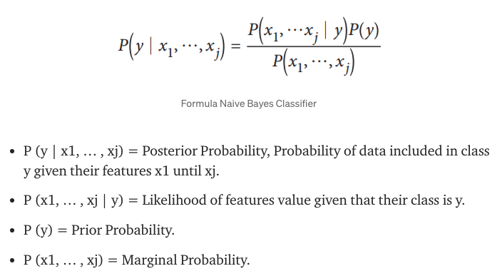
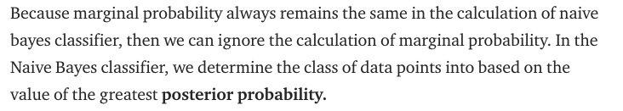
Next 4 weeks

Slide 8
Next 4 weeks

